Slide 1
Object-Oriented Design
Assignment 5
(Use Case/Class/Sequence/State Diagram/Traceability Matrix)
By: Group 13
Nopphiphat Suraminitkul (Nopi)
Ayush Singh
Juhi Sinha
Somnath Jogelkar

Slide 2
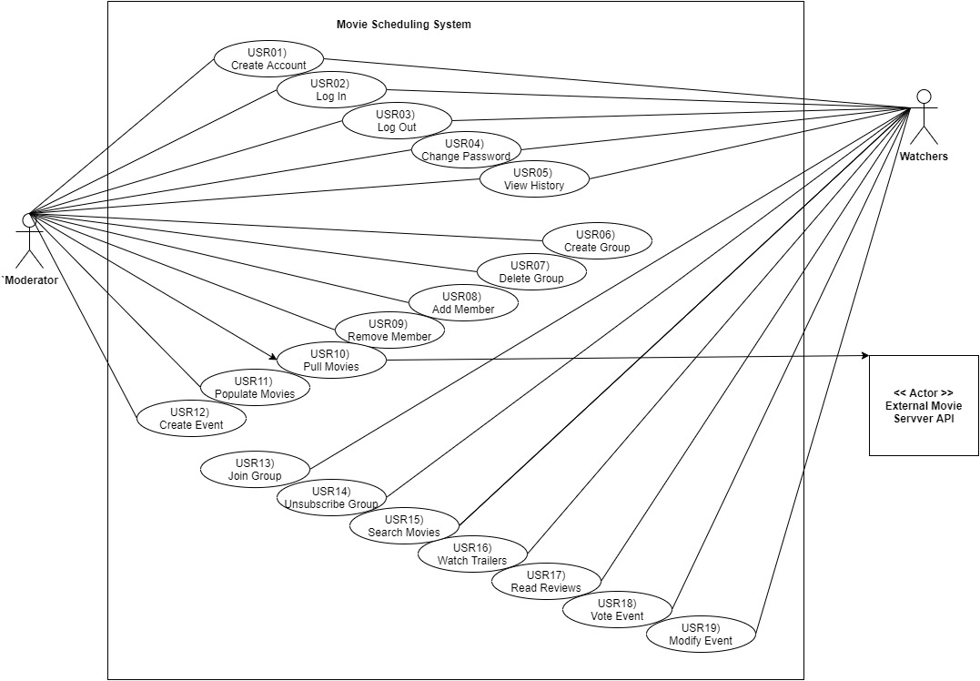
Use Case Diagram

Slide 3
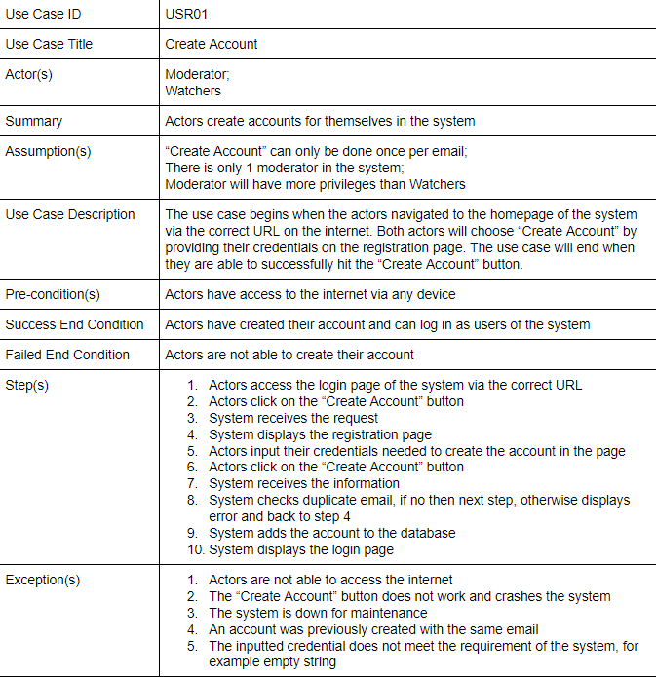

Slide 4
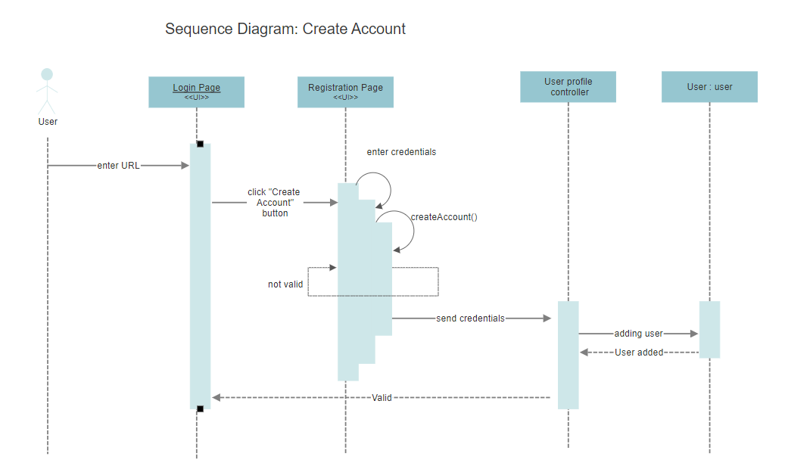
Notes:
API Interface
Traceability with test case
Control class does not deal directly with the

Slide 5
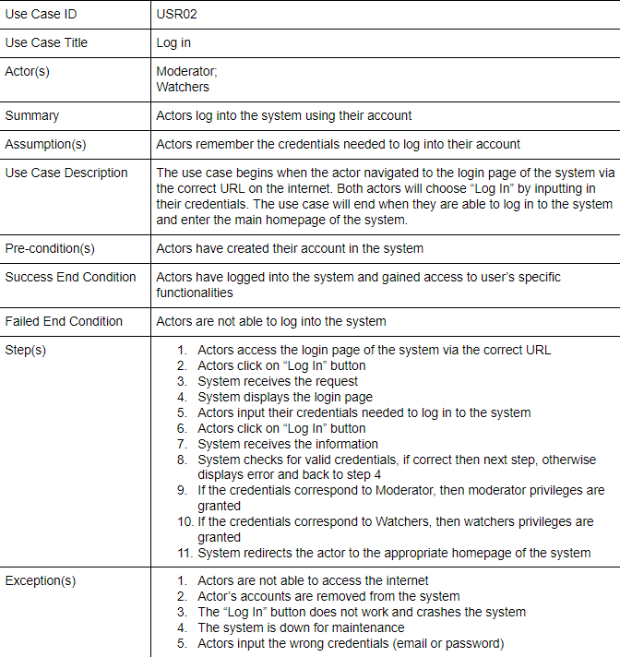

Slide 6
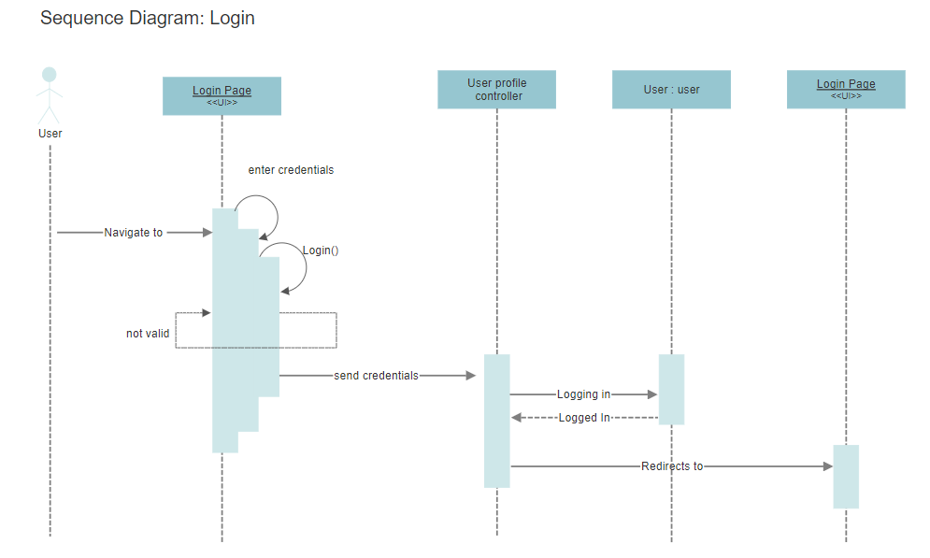
Notes:
API Interface
Traceability with test case
Control class does not deal directly with the

Slide 7
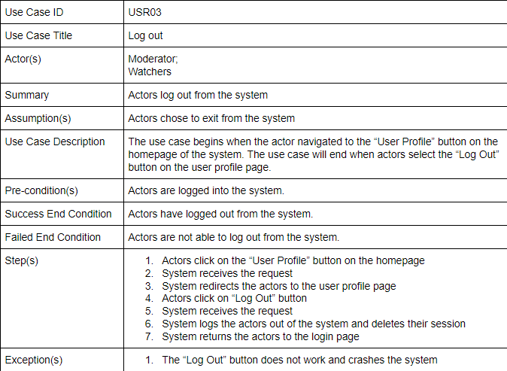

Slide 8
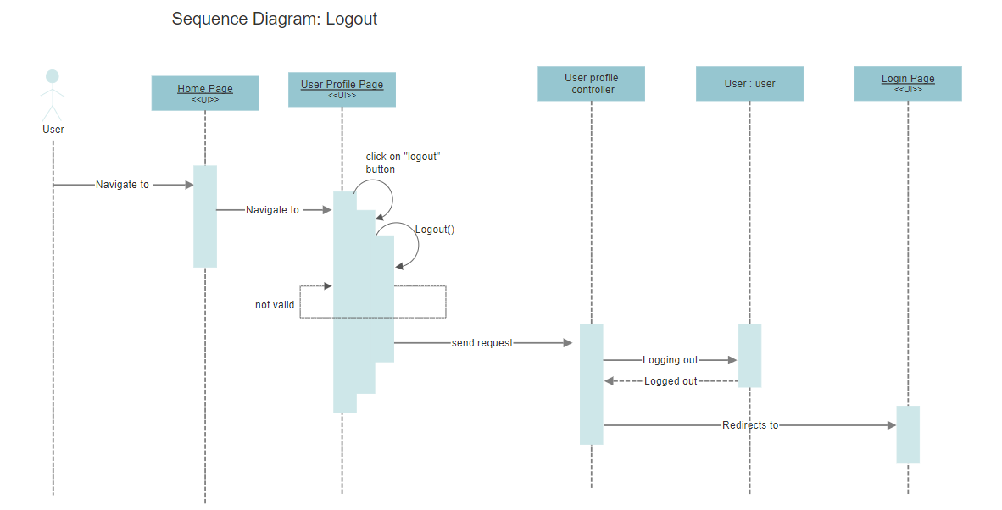
Notes:
API Interface
Traceability with test case
Control class does not deal directly with the

Slide 9
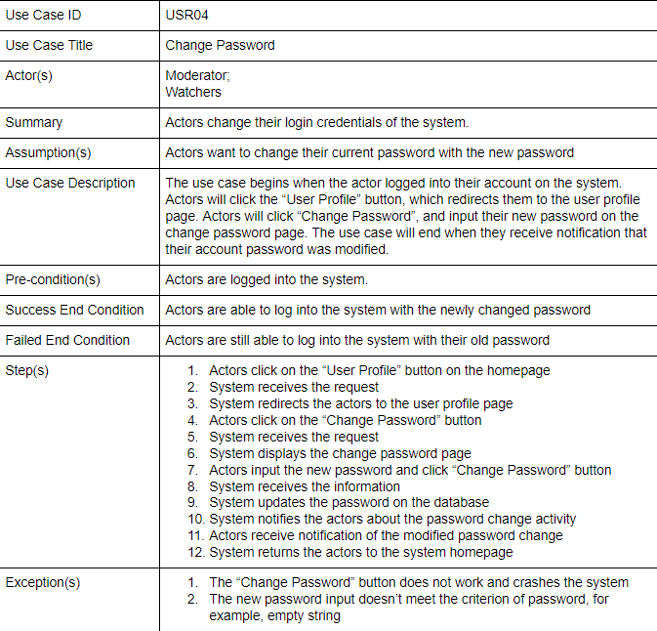

Slide 10
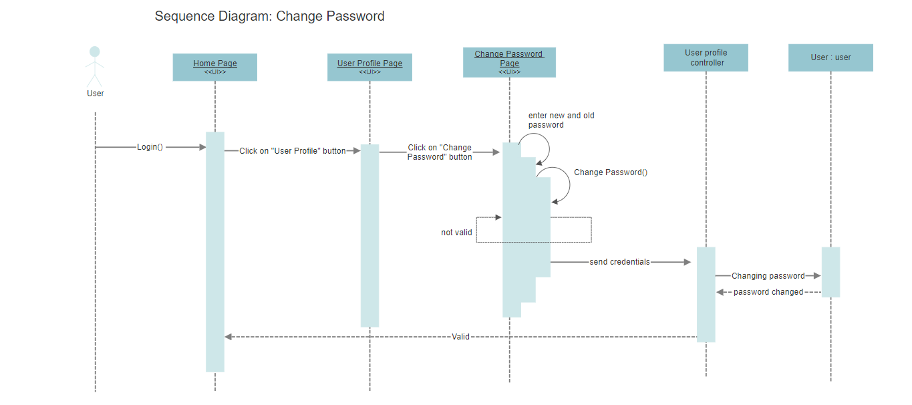
Notes:
API Interface
Traceability with test case
Control class does not deal directly with the

Slide 11
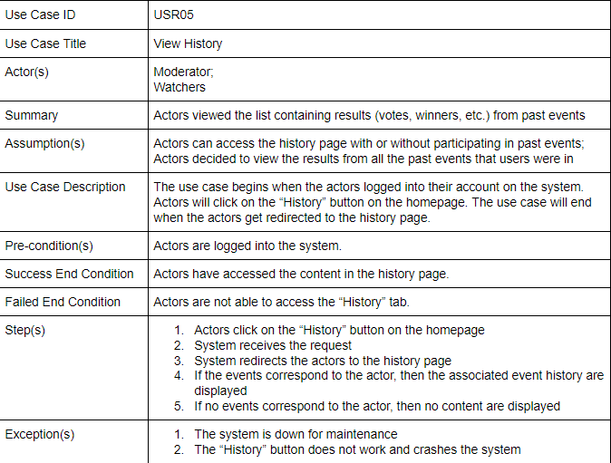

Slide 12
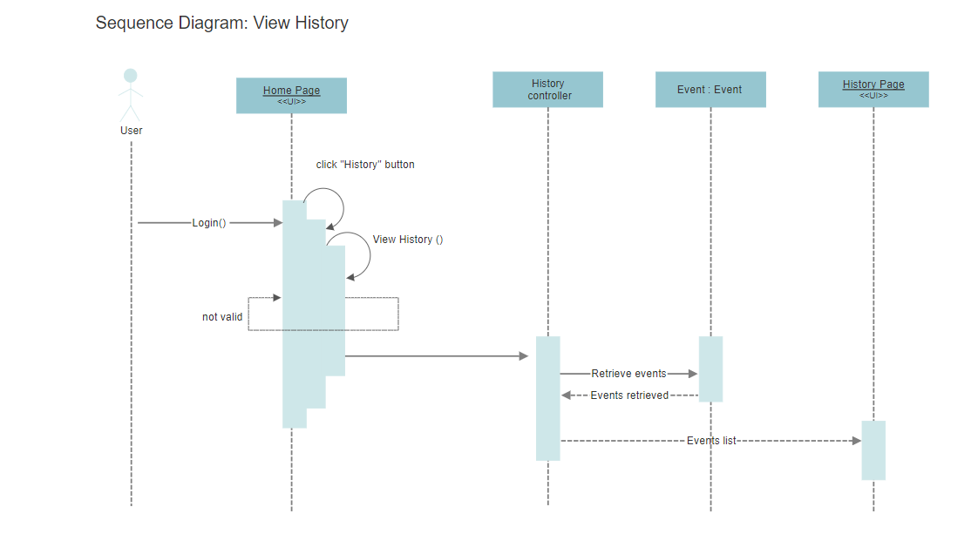
Notes:
API Interface
Traceability with test case
Control class does not deal directly with the

Slide 13
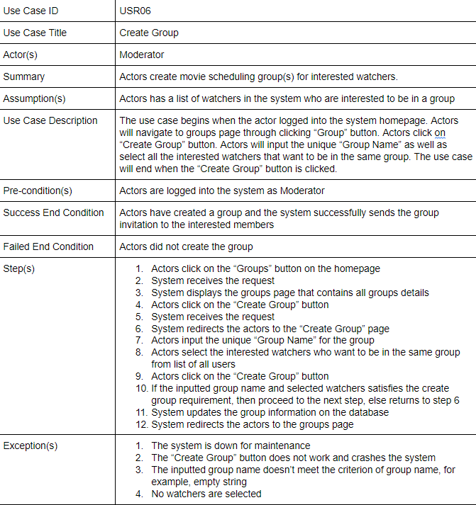

Slide 14
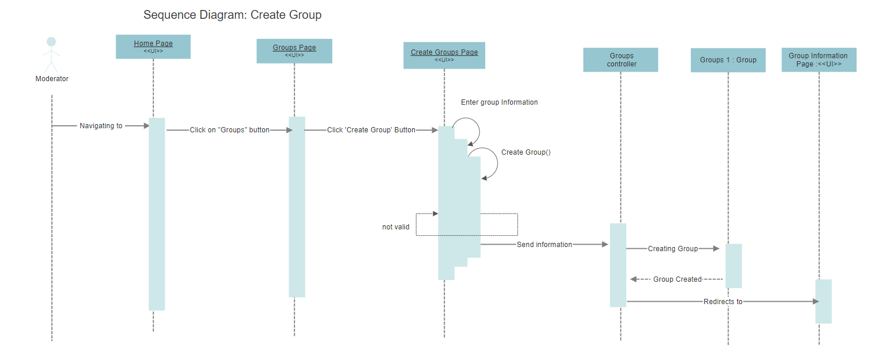
Notes:
API Interface
Traceability with test case
Control class does not deal directly with the

Slide 15
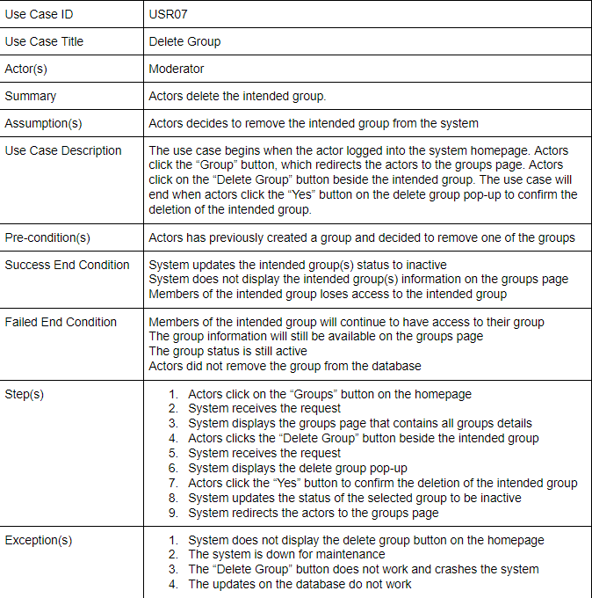

Slide 16
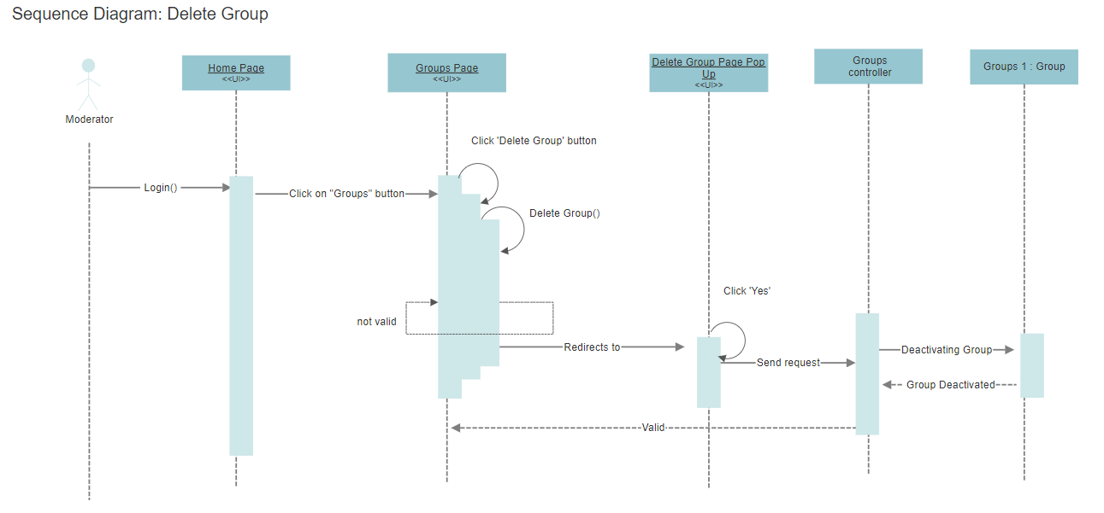
Notes:
API Interface
Traceability with test case
Control class does not deal directly with the

Slide 17
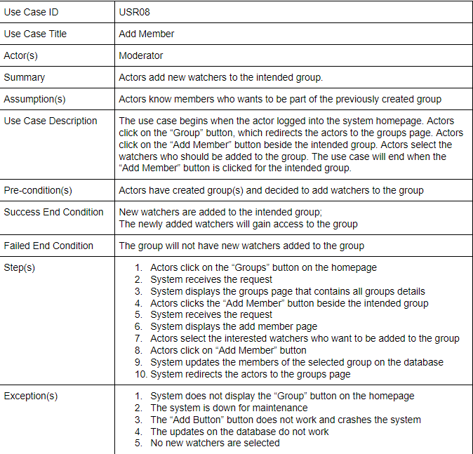

Slide 18
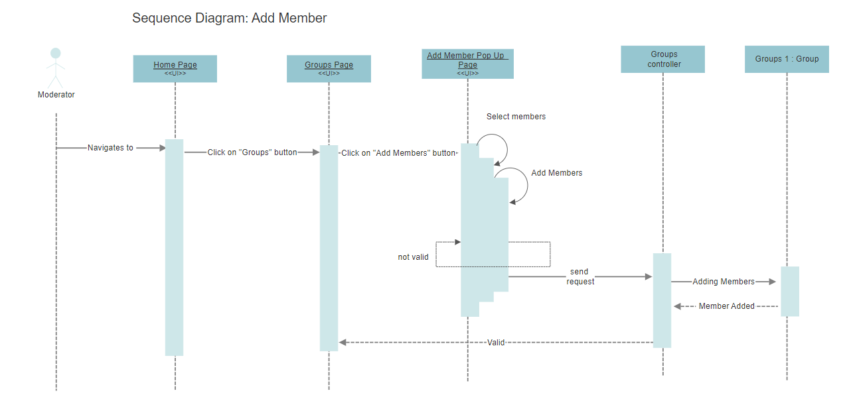
Notes:
API Interface
Traceability with test case
Control class does not deal directly with the

Slide 19
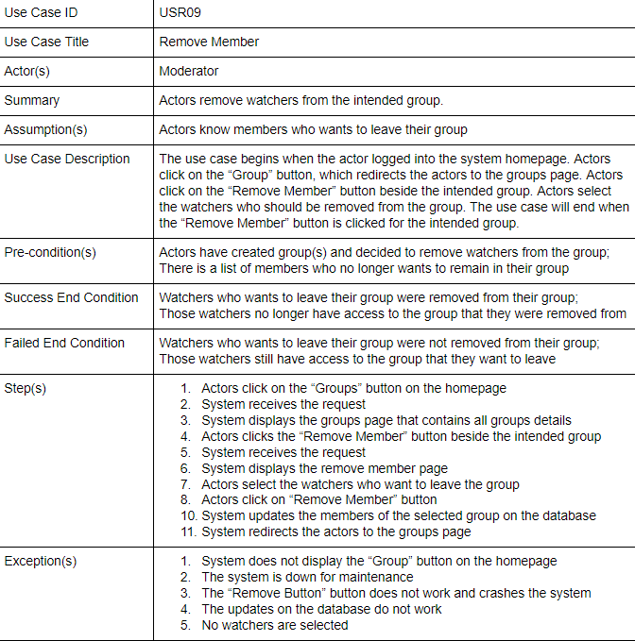

Slide 20
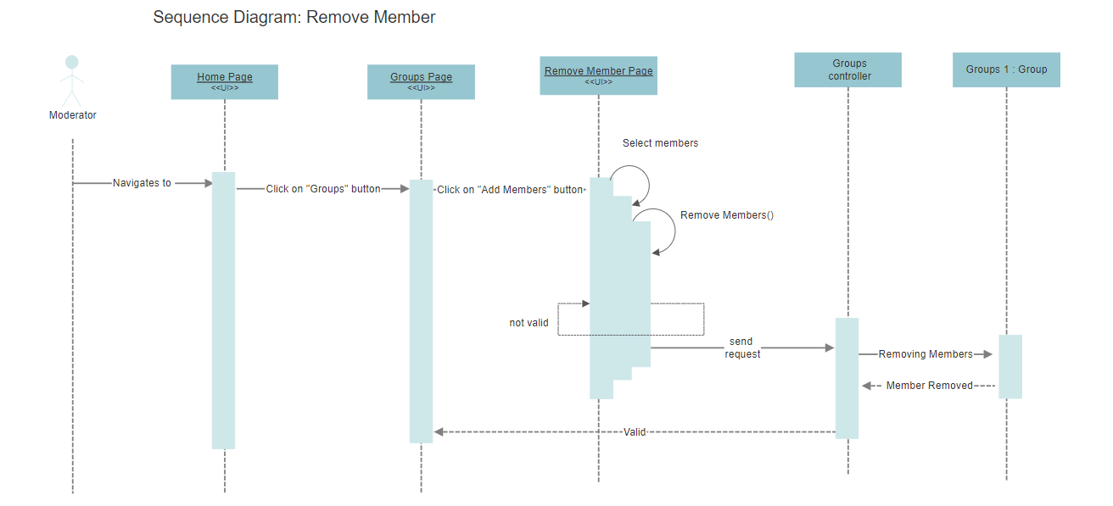
Notes:
API Interface
Traceability with test case
Control class does not deal directly with the

Slide 21
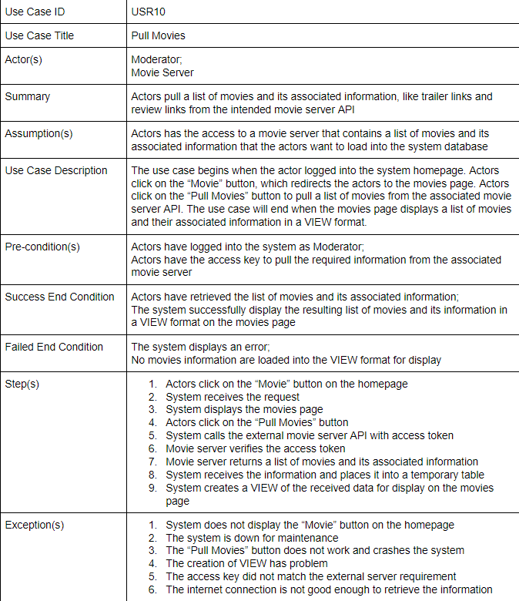

Slide 22
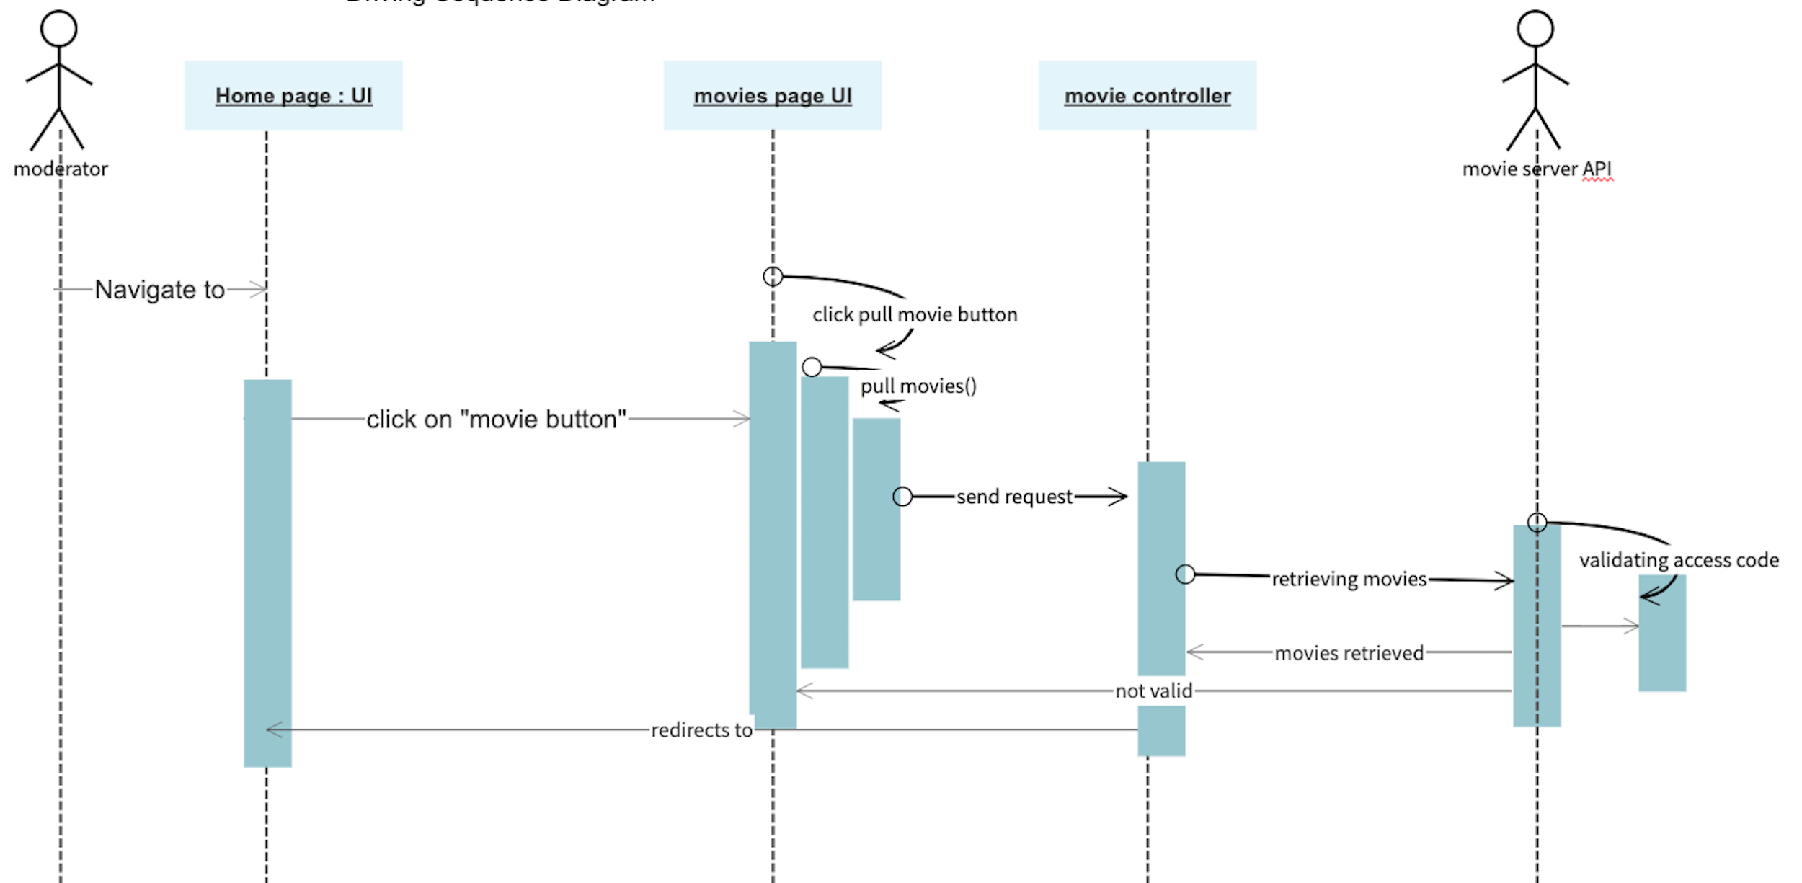
Pull movies

Slide 23
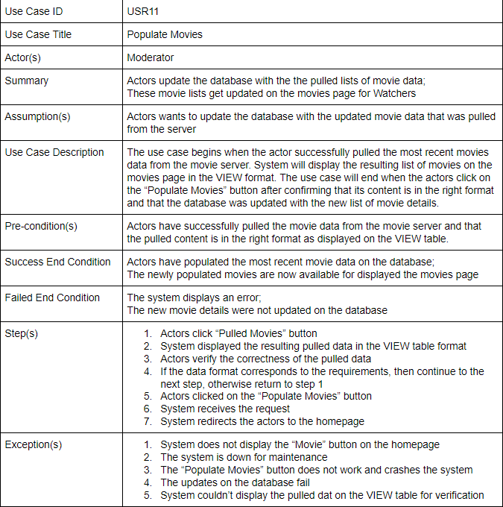

Slide 24
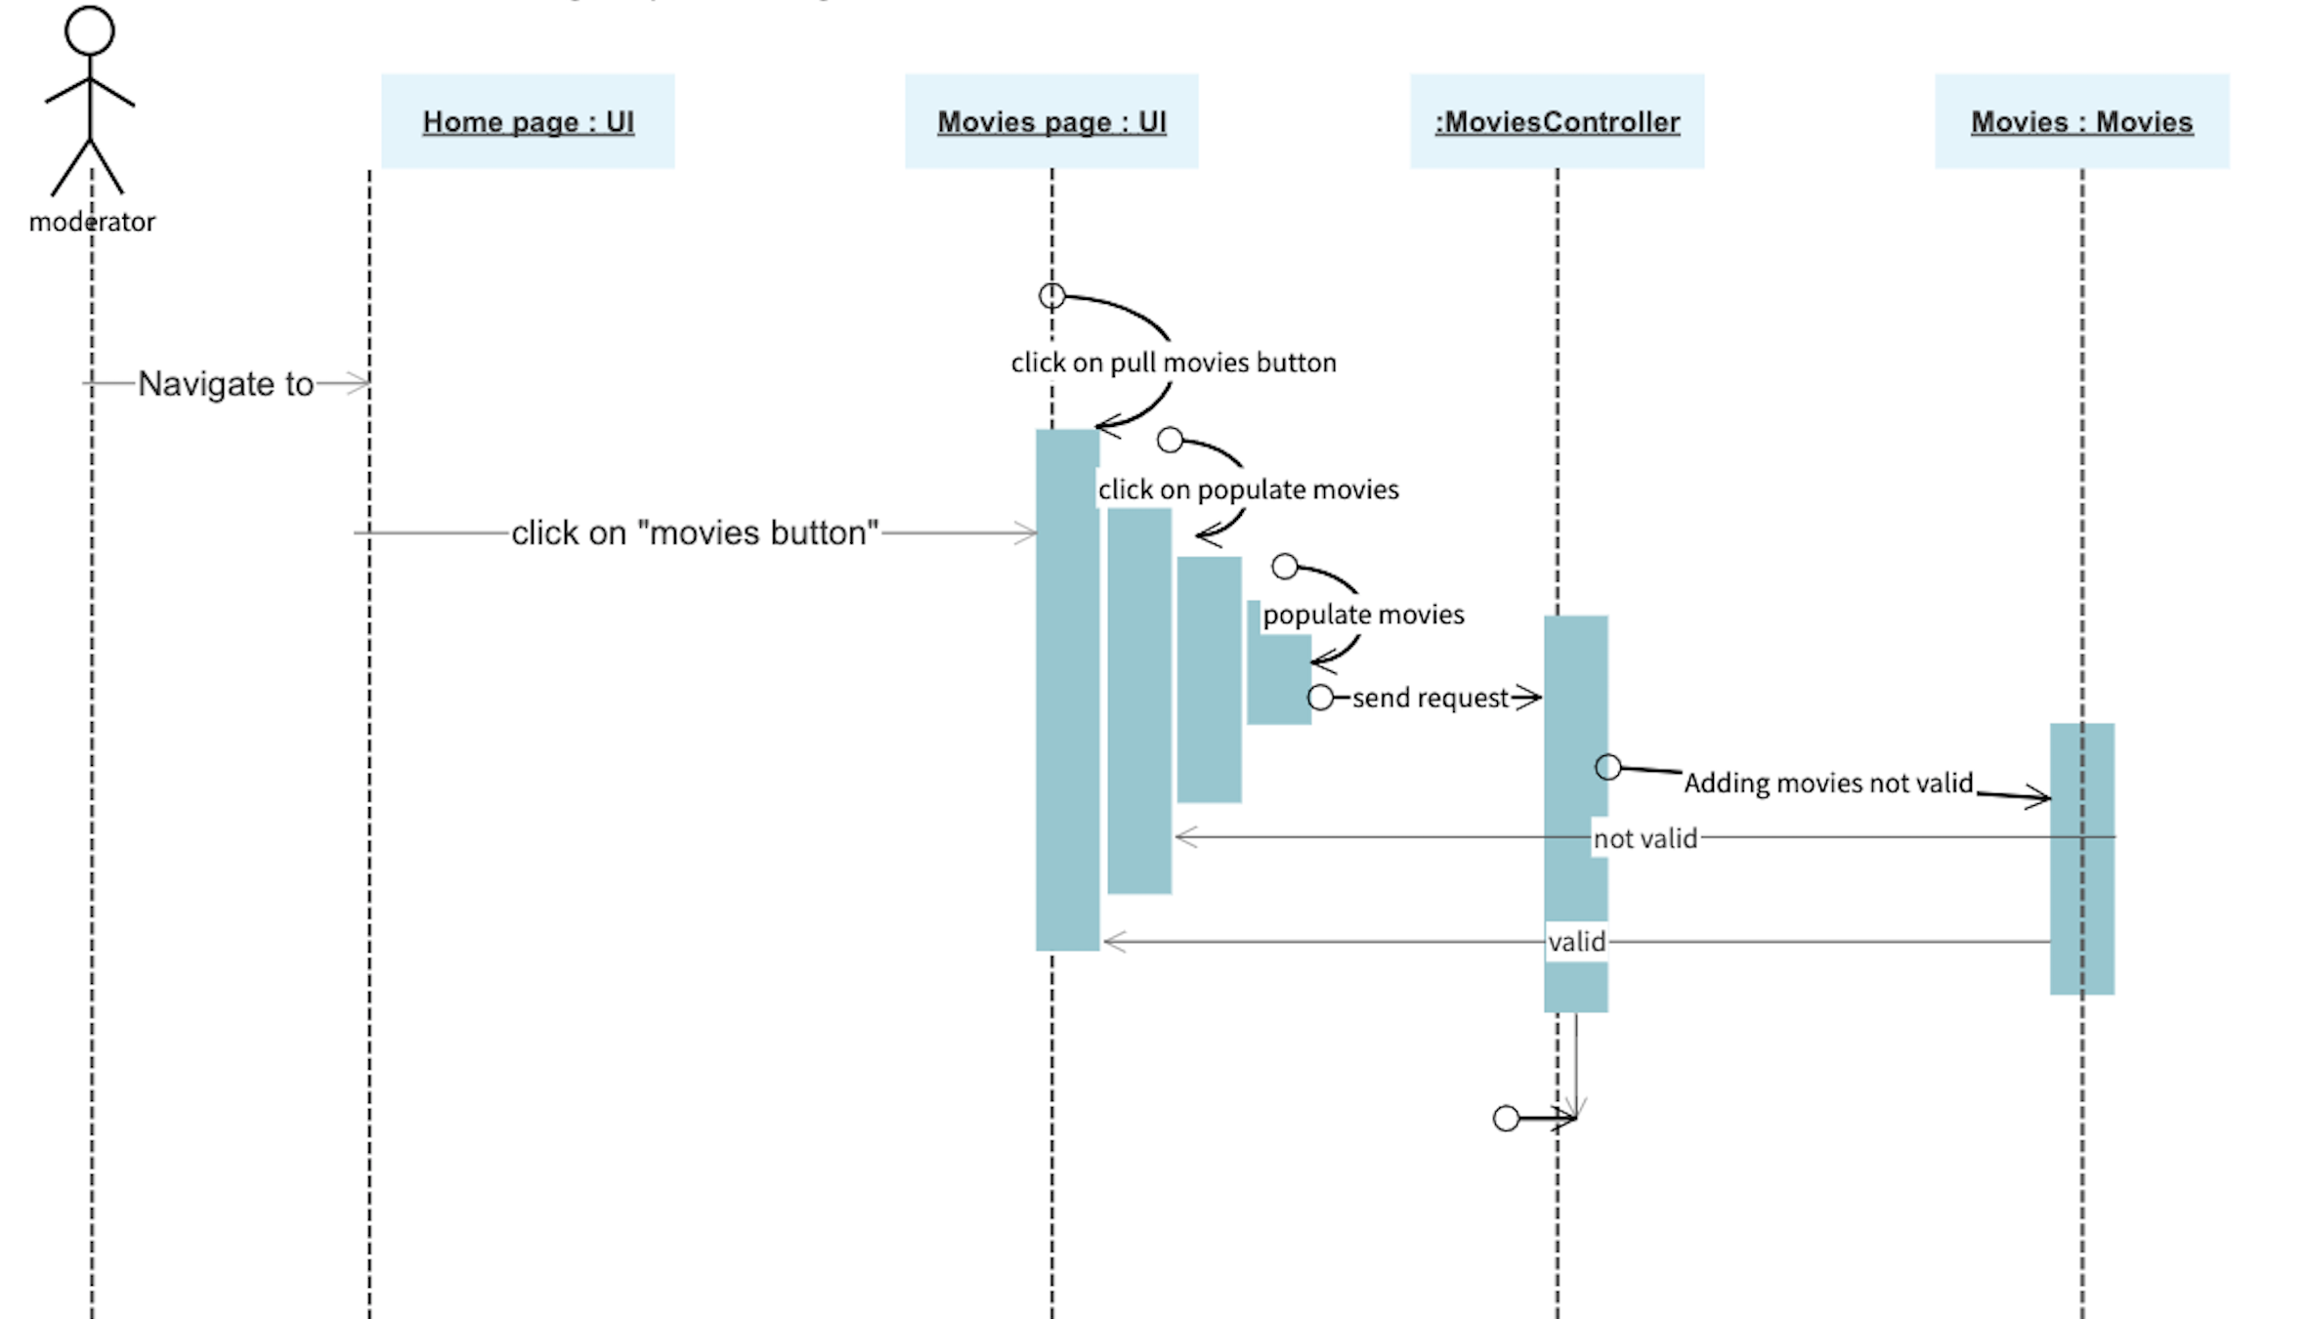
Populate movie

Slide 25
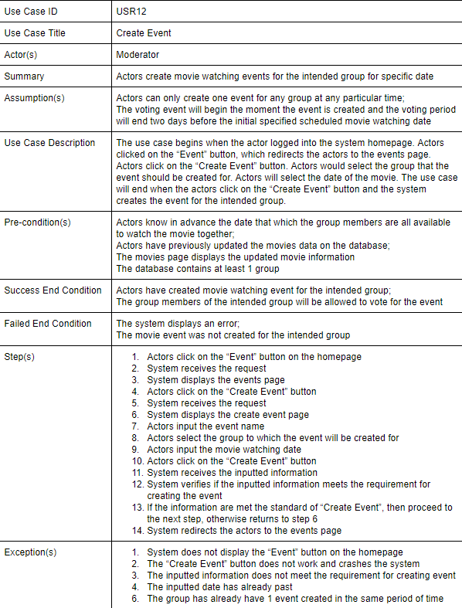

Slide 26
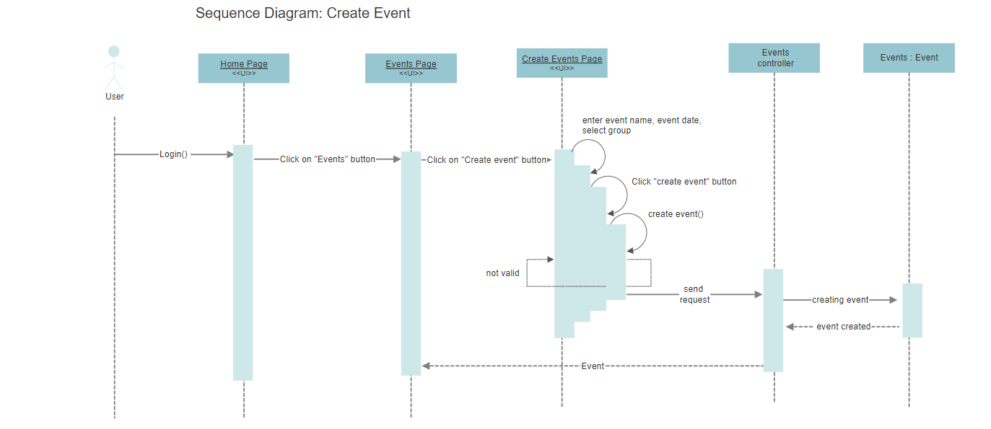
Notes:
API Interface
Traceability with test case
Control class does not deal directly with the

Slide 27
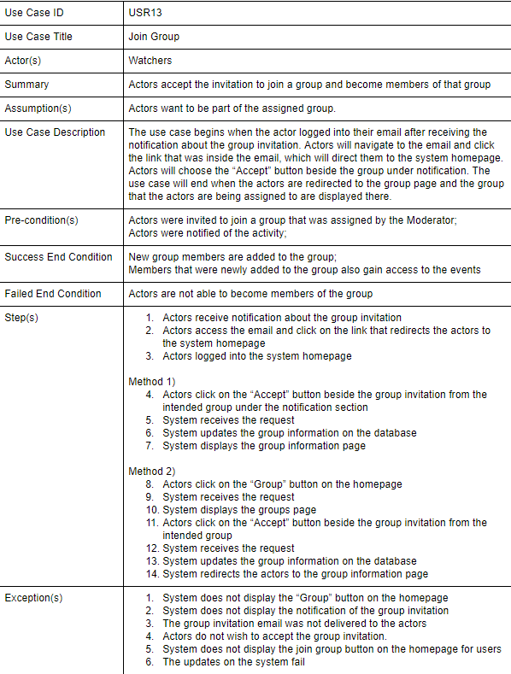

Slide 28
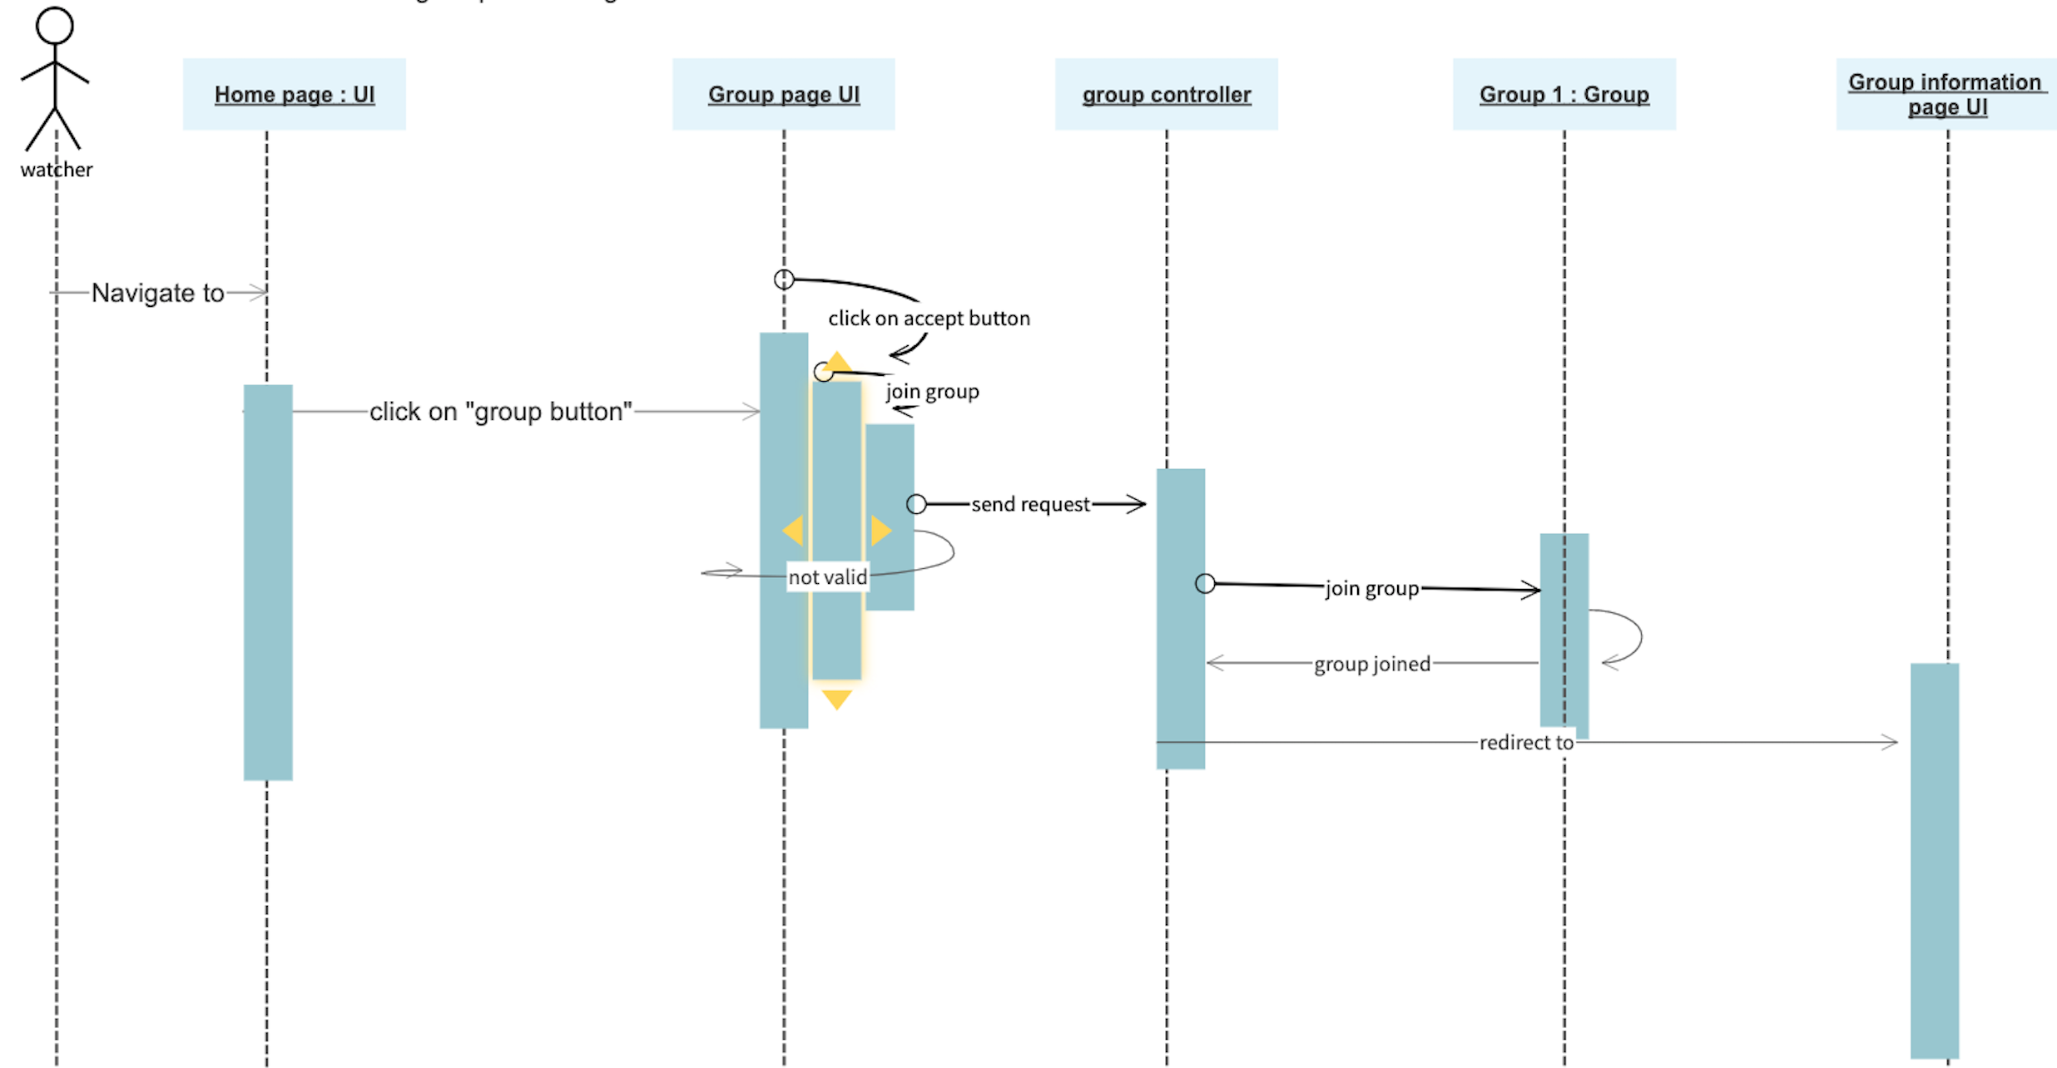
Join group

Slide 29
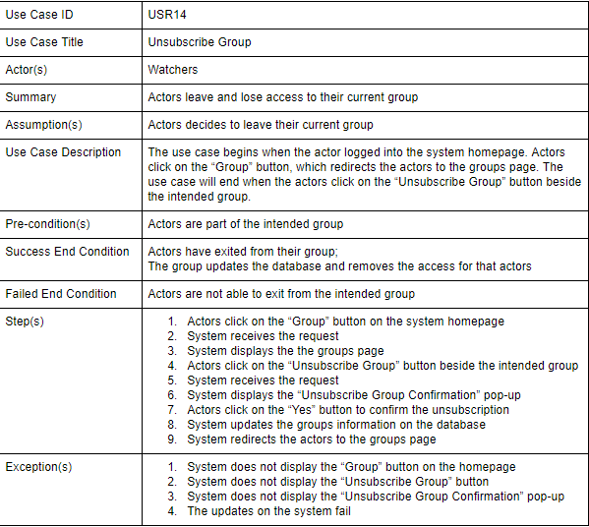

Slide 30
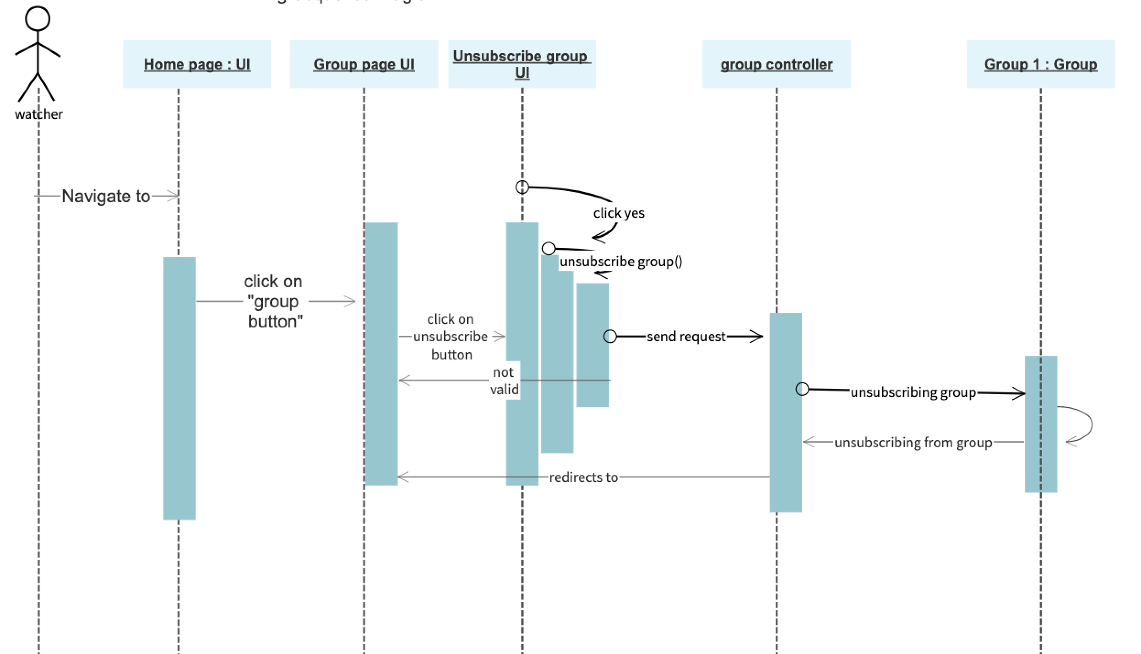
Unsubscribe group

Slide 31
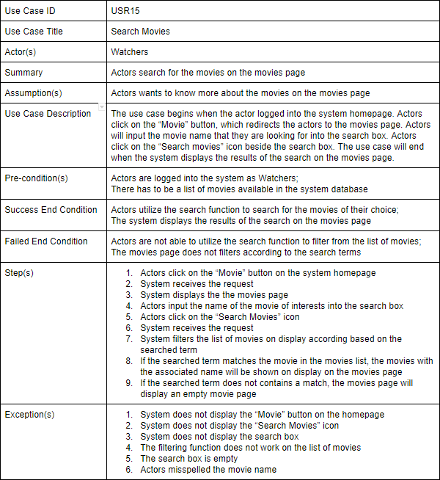

Slide 32
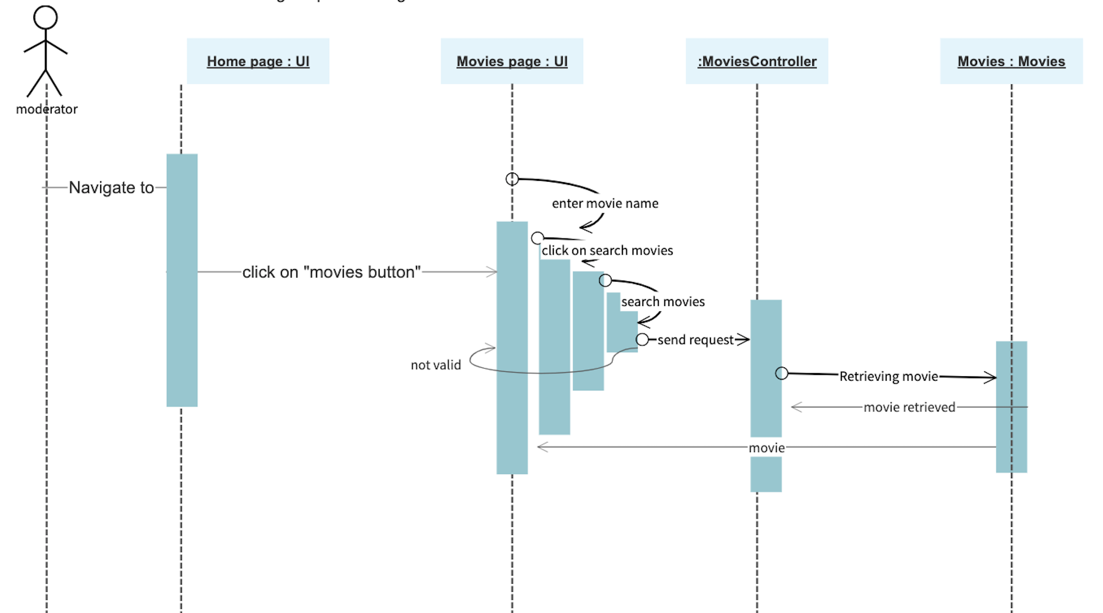
Search movie

Slide 33
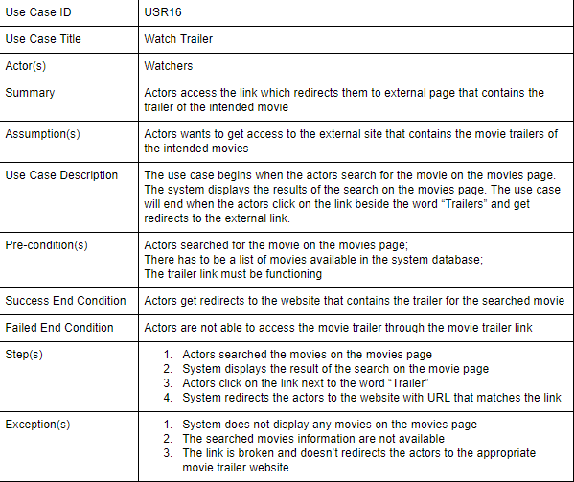

Slide 34
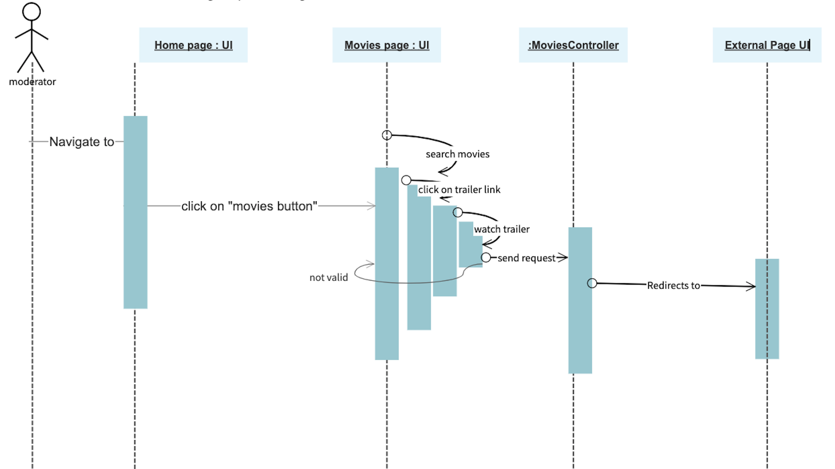
Watch trailer

Slide 35
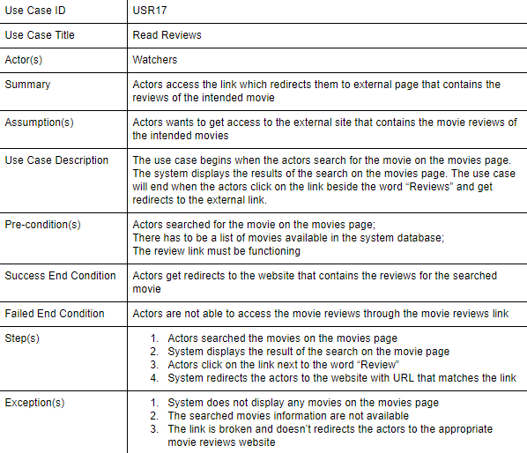

Slide 36
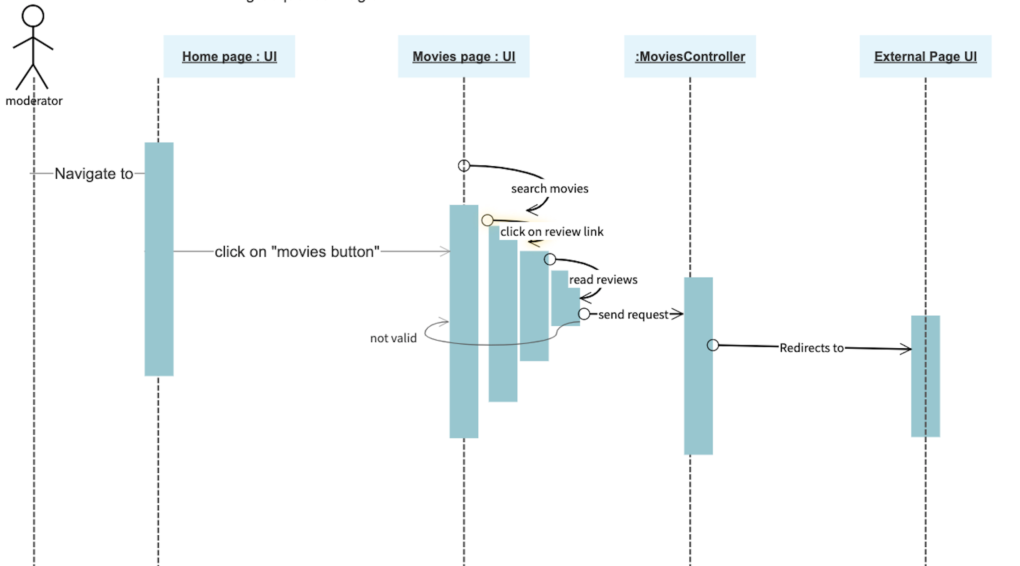
Read Reviews

Slide 37
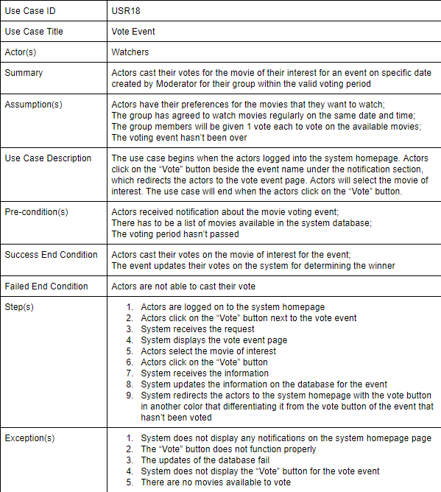

Slide 38
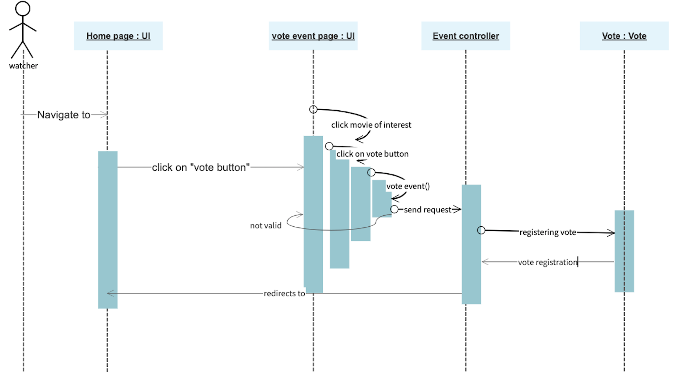
Vote Event

Slide 39
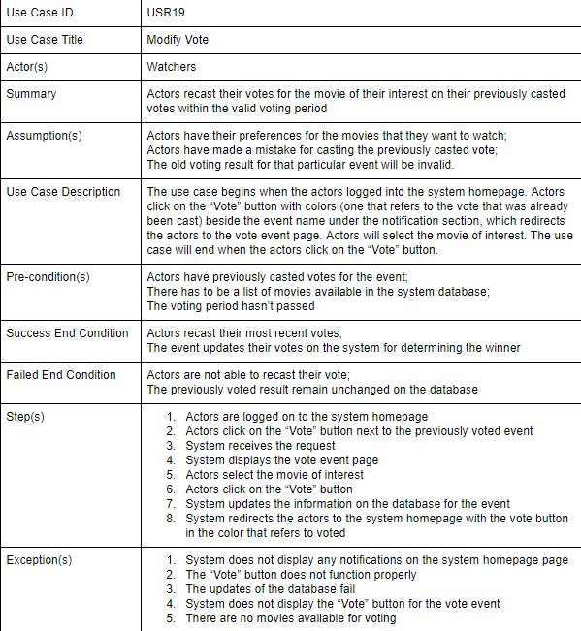

Slide 40
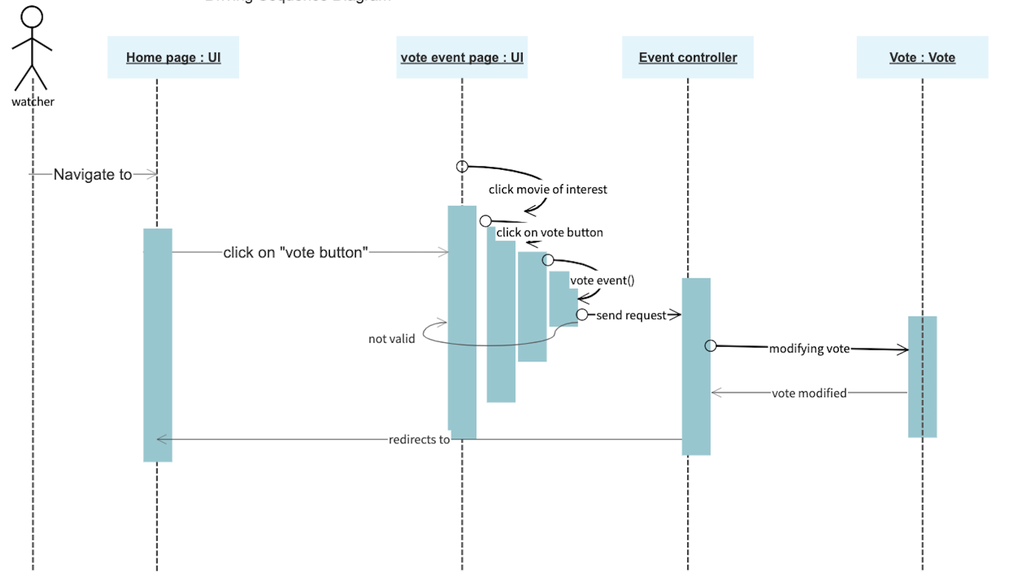
Modify Vote

Slide 41
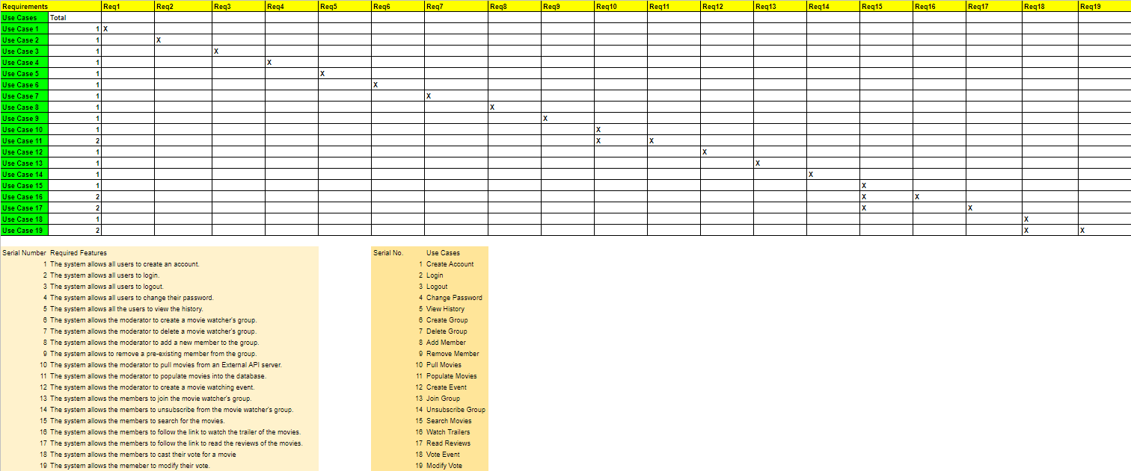
Bi-Directional Traceability Matrix

Slide 42
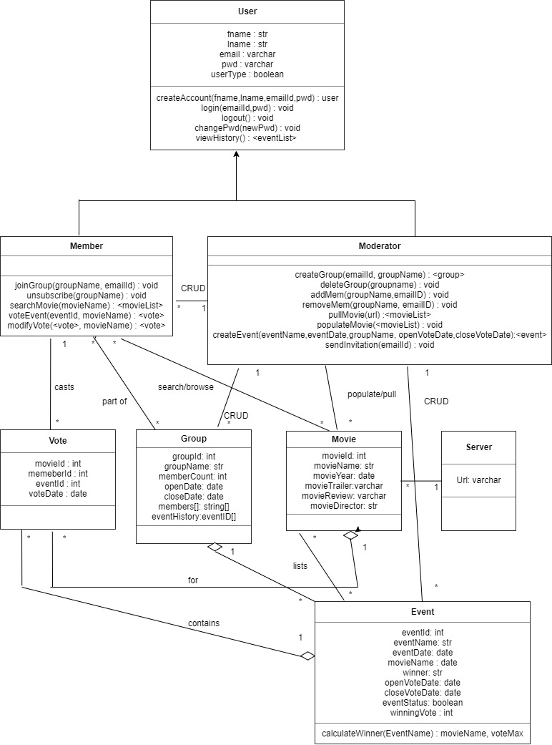
Class Diagram

Slide 43
Class Description
User: This class provides description of superuser that contains common operations by Moderator and Watcher, like create account, log in, and view history.
Moderator: This class provides description of admin that operates the system, like manage groups and members, create event, and pull movies.
Member(Watcher): This class provides description of user that uses the system, like search movies and vote event.
Vote: This class provides the attributes of a vote casted by the member (watcher) of the group. The attributes contains MovieID, MemberID, EventID and Vote Date.
Group: This class provides the attributes of a group of which members are part of and which moderators created. The attributes contains GroupID, GroupName, MemberCount to name a few.
Movie: The attributes contains the attributes of a movie that has been pulled an populated into the groups with movie trailers links and review links related to the movie.
Server/API: This is the secondary actor that will provide the movie list with trailer/review links and will be pulled by the moderator.
Event: This class provides the information about the events that are created by the moderator for the members of the group to vote for movies

Slide 44
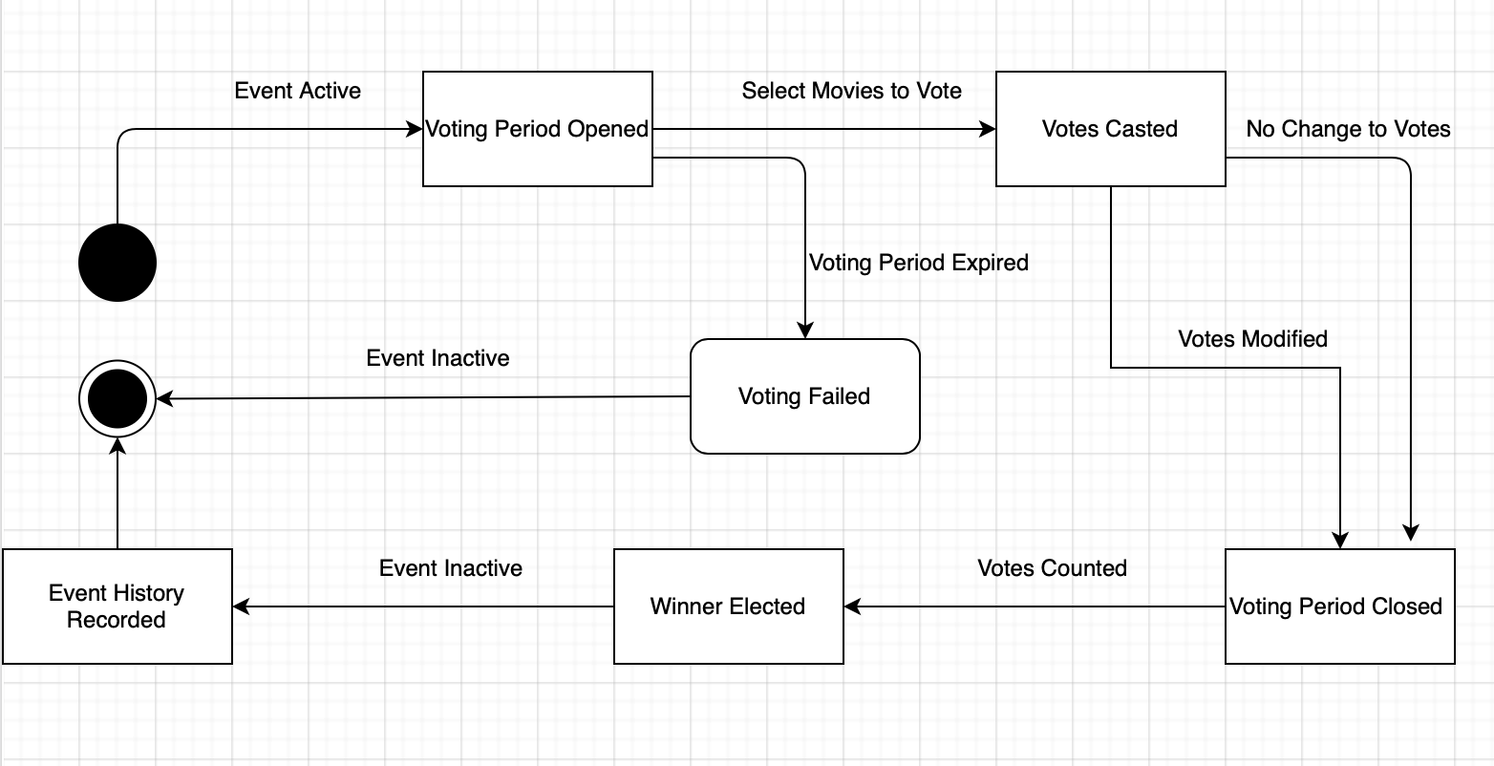
State Diagram (Voting)

Slide 45
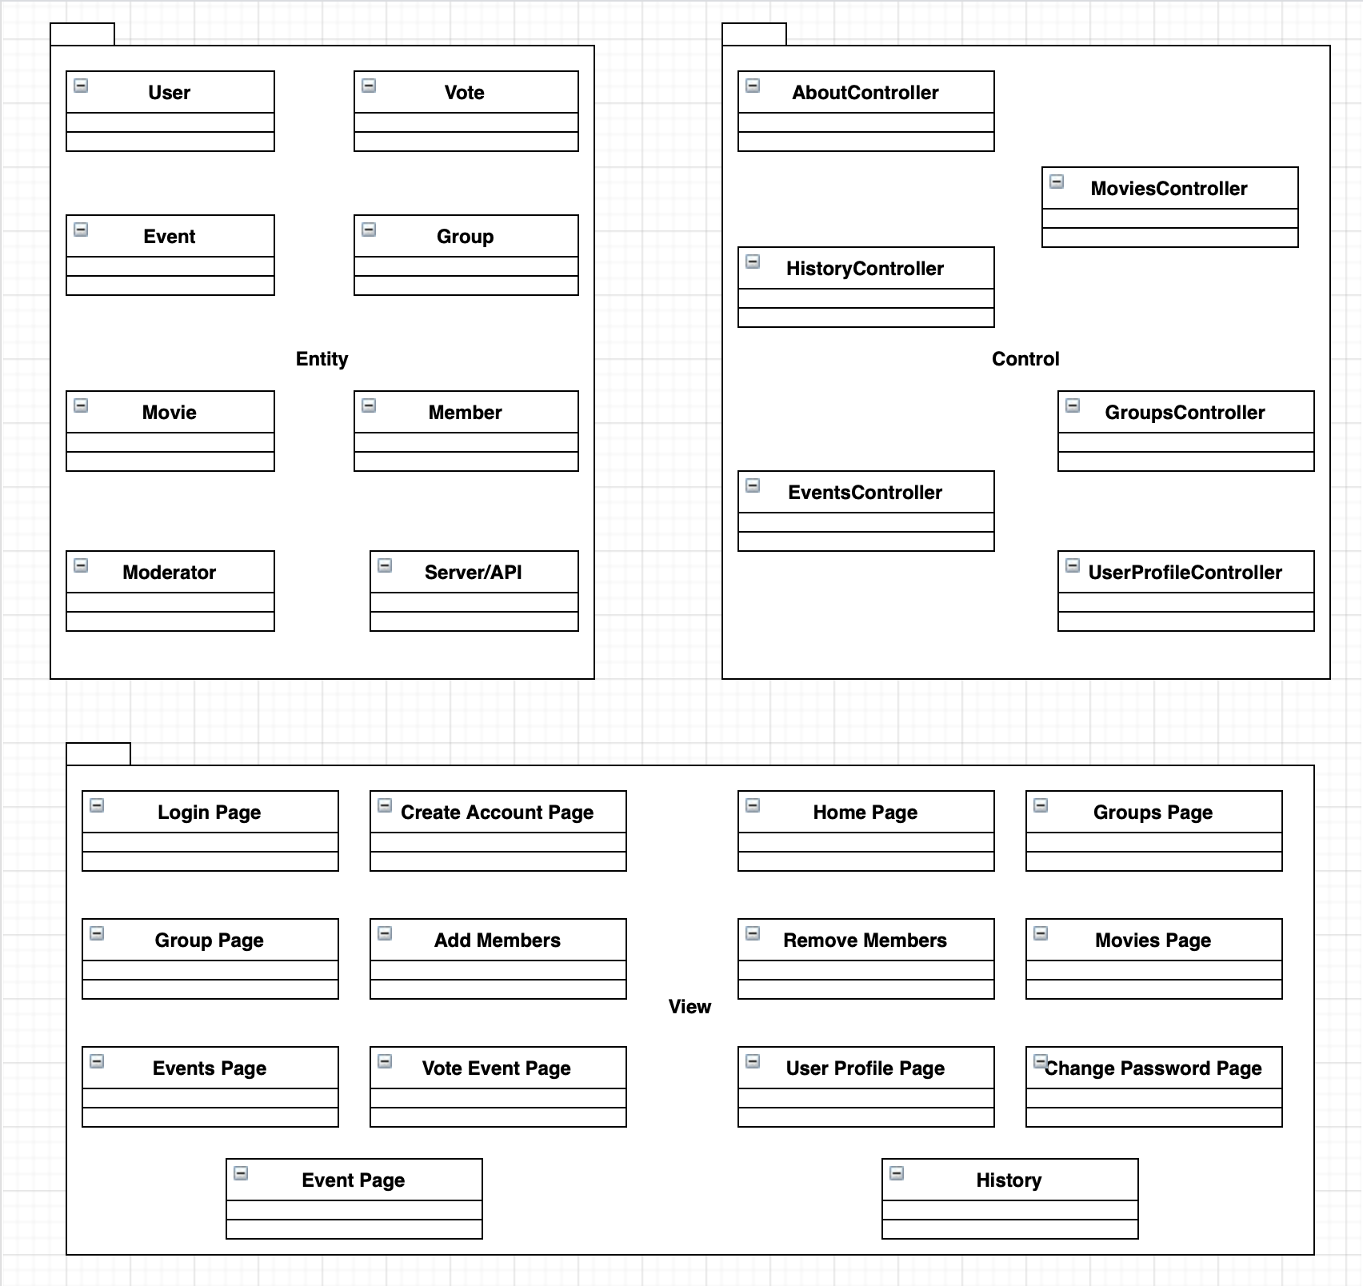
UML Package
Diagram

Slide 46
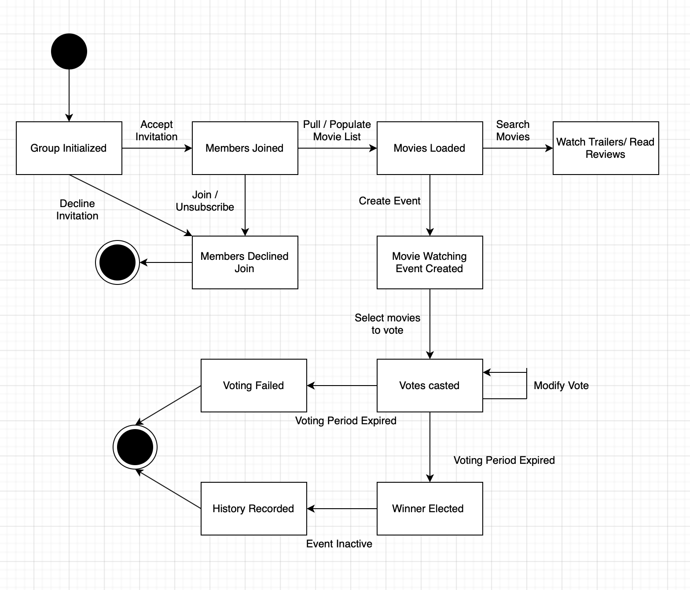
Activity Diagram
Notes:
Activity Diagram/Process Model: State Diagram is for a class.

